Slide 1


Machine Learning Evaluation Implementing Responsible and Reliable AI Nathalie Japkowicz American University, Washington DC Zois Boukouvalas American University, Washington DC
IEEE Big Data 2024
Dec 15-18, 2024 @ Washington DC, USA
'By its nature, machine learning has always had evaluation at its heart. As the authors of this timely and important book note, the importance of doing evaluation properly is only increasing as we enter the age of machine learning deployment. The book showcases Japkowicz' and Boukouvalas' encyclopedic knowledge of the subject as well as their accessible and lucid writing style. Quite simply required reading for machine learning researchers and professionals.' Peter Flach, University of Bristol

Slide 2
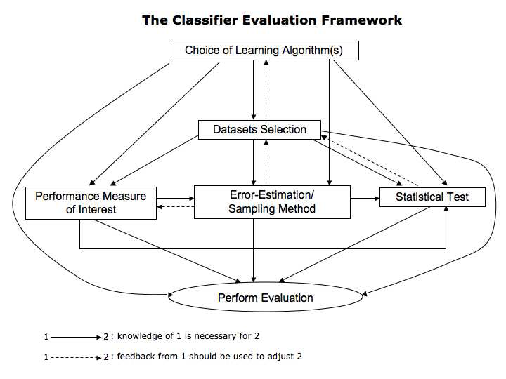
The main steps of classifier evaluation

Slide 3
What these steps depend on
These steps depend on the purpose of the evaluation:
Comparison of a new algorithm to other (may be generic or application-specific) classifiers on a specific domain (e.g., when proposing a novel learning algorithm)
Comparison of a new generic algorithm to other generic ones on a set of benchmark domains (e.g. to demonstrate general effectiveness of the new approach against other approaches)
Characterization of generic classifiers on benchmarks domains (e.g. to study the algorithms' behavior on general domains for subsequent use)
Comparison of multiple classifiers on a specific domain (e.g. to find the best algorithm for a given application task)

Slide 4
But these core aspects of evaluation are not all…
There also are:
Safety and Data imperfections issues
Safety and Algorithmic imperfections issues
Safety and Platform and Implementation issues
Data Bias
Lack of Explainability
Fairness issues
Privacy and security issues
Repeatability, reproducibility, and replicability issues

Slide 5
Going beyond Classification…
Though Classification is a core subdiscipline of machine learning, it is by no means the only one:
Unsupervised Learning
Regression
Multi-Label Classification
Image Segmentation
Text Generation
Time Series Analysis
Data Stream Mining

Slide 6
Outline of the tutorial:
Topics:
Classification
Choosing a performance measure
Sampling
Choosing a statistical test
Other ML Paradigms
Machine Learning Deployment
Reliability and Responsibility
Note: In this tutorial, we present highlights from the book. The book, itself, contains many more topics and illustrations, all explored in greater depth.

Slide 7
Classification
Choosing a performance metric

Slide 8
The confusion matrix
 | Positive | Negative
Yes | True Positives (TP) | False Positives (FP)
No | False Negatives (FN) | True Negatives (TN)
Column Totals | P | N

Slide 9
Common evaluation metrics
FP Rate = FP/N (False Alarm Rate)
Precision = TP/(TP+FP)
Accuracy = (TP+TN)/(P+N)
TP Rate = TP/P = Recall = Hit Rate = Sensitivity
F-Score = Precision * Recall (though a number of other formulae are also acceptable)
ROC Analysis

Slide 10
Do evaluation metrics agree?

Slide 11
Overview of classification metrics for classification

Slide 12
The ambiguity of Accuracy
True class → | Pos | Neg
Yes | 200 | 100
No | 300 | 400
 | P=500 | N=500
True class → | Pos | Neg
Yes | 400 | 300
No | 100 | 200
 | P=500 | N=500
Both classifiers obtain 60% Accuracy
However, they exhibit very different behavior:
On the left: weak positive recognition rate/strong negative recognition rate
On the right: strong positive recognition rate/weak negative recognition rate

Slide 13
The ambiguity of Precision/Recall
True class → | Pos | Neg
Yes | 200 | 100
No | 300 | 400
 | P=500 | N=500
True class → | Pos | Neg
Yes | 200 | 100
No | 300 | 0
 | P=500 | N=100
Both classifiers obtain the same precision and Recall values of of 66.7% and 40% (Note: the data sets are different)
However, they exhibit very different behavior:
Same positive recognition rate of
Extremely different negative recognition rate: strong on the left / nil on the right

Slide 14
Recommendation
Familiarize yourself with all the performance metrics available for your task.
Understand the requirements of your domain.
Match these requirements to the metrics and select a few candidates.
Insure yourself that the candidate metrics are appropriate for the other steps of evaluation.
In short: choosing evaluation metrics for a task should not be done randomly. The researcher or practitioner should think logically about the implications of their choices!

Slide 15
Classification
Resampling

Slide 16
What is the purpose of resampling?
Ideally, we would have access to the entire population or a lot of representative data from it.
This is usually not the case, and the limited data available has to be re-used in clever ways in order to be able to estimate the error of our classifiers as reliably as possible, i.e., to be re-used in clever ways in order to obtain sufficiently large numbers of samples.
Resampling is divided into two categories: Simple re-sampling (where each data point is used for testing only once) and Multiple re-sampling (which allows the use of the same data point more than once for testing)

Slide 17
What are the dangers of resampling?
Resampling is usually followed by Statistical testing. Yet statistical testing relies on the fundamental assumption that the data used to obtain a sample statistics must be independent.
However, if data is re-used, then this important independence assumption is broken, and the result of the statistical test risks being invalid.
In addition to discussing a few re-sampling approaches, we will underline the issues that may arise when applying them.

Slide 18
Overview of resampling methods

Slide 19
K-fold crossvalidation
Fold 1:
Fold 2:
Fold k-1:
Fold k:
…..
: training data subset
: testing data subset
In Cross-Validation, the data set is divided into k folds and at each iteration, a
different fold is reserved for testing and all the others, used for training the
classifiers.

Slide 20
Some variations of crossvalidation
Stratified k-fold Cross-Validation:
This variation is useful when the class-distribution of the data is skewed. It ensures that the distribution is respected in the training and testing sets created at every fold. This would not necessarily be the case if a pure random process were used.
Leave one out:
In k-fold Cross-Validation, each fold contains m/k data points where m is the overall size of the data set. In leave one out, k =m and therefore, each fold contains a single data point.

Slide 21
Considerations about k-fold crossvalidation and its variants
k-fold crossvalidation is the best known and most commonly used resampling technique.
k-fold crossvalidation is less computer intensive than leave one out.
The testing sets are independent of one another, as required by many statistical testing methods, but the training sets are highly overlapping. This can affect the bias of the error estimates.
Leave one out produces error estimates with high variance given that the testing set at each fold contains only one example. The classifier is practically unbiased since each fold trains on almost all the data.

Slide 22
Bootstrapping
Bootstrapping creates a large number of new samples from the available dataset by drawing from replacement from the available sample.
Bootstrapping is useful in practice when the sample is too small for crossvalidation or Leave One Out approaches to yield a good estimate.
There are two bootstrap estimates that are useful in the context of classification: the Є0 and the e632 Bootstrap.
The Є0 bootstrap tends to be pessimistic because it is only trained on 63.2% of the data in each run. The e632 attempts to correct for this.

Slide 23
The Є0 and e632 Bootstraps
Given a data set D of size m, we create k bootstrap samples B_{i} of size m by samplking deom D with replacement (k is typically larger than 200).
At each run, each of the k bootstraps represents the training set while the testing set is made up of a single copy of the examples from D that did not make it to B_{i}.
At each run a classifier is trained and tested and Є0_{i} represents the performance of the classifier at that run.
Є0 represents the average of all the Є0_{i}‘s.
e632 = 0.632 x Є0 = 0.368 x err(f)
where err(f) is the optimistically biased resubstitution error

Slide 24
Considerations about bootstrapping
Bootstrapping yields better estimates than crossvalidation and its variants when the data set is very small.
The results of bootstrapping in such cases was shown to have low variance.
The Є0 bootstrap is a good estimator when the true error rate is very high.
The e632 bootstrap is a good estimator on small data sets especially if the true error rate is small.
Bootstrapping is a poor estimator for certain types of classifiers that do not benefit from the presence of duplicate instances. (E.g., k-NN with clones removed)

Slide 25
Repeated k-fold crossvalidation I
In order to obtain more stable estimates of an algorithm’s performance, it is useful to perform multiple runs of simple re-sampling schemes. This can also enhance replicability of the results.
Two specific schemes have been suggested in the context of crossvalidation: 5x2 crossvalidation and 10x10 crossvalidation.
k-fold crossvalidation does not estimate the mean of the difference between 2 learning algorithms properly. The mean at a single fold behaves better. This led Dietterich (1998) to propose the 5x2 crossvalidation regimen, in which 2-fold crossvalidation is repeated 5 times. Dietterich also proposed a statistical test for this case.

Slide 26
Repeated k-fold crossvalidation II
Dietterich found that the paired t-test based on the 5x2 crossvalidation scheme had lower probability of issuing a type-I error but had less power than the k-fold crossvalidation paired t-test.
Alpaydyn (1999) proposed to substitute the t-test at the end of the 5x2CV scheme proposed by Dietterich by an F-test. That test has an even lower chance of issuing a type-I error and has increased power.
Bouckahert (2003) proposed several variations of a 10x10 crossvalidation scheme. Generally speaking, these schemes show a higher probability of Type-I error than 10-fold crossvalidation, but higher power.

Slide 27
A few remarks about averaging
When considering resampling methods, it is usually necessary to average the results obtained on different trials.
We distinguish between different kinds of averaging:
Micro Averaging: calculate metrics globally by counting the total true positives, false negatives, and false positives.
The performances of the large classes weigh more than those of the small classes.
Macro Averaging: calculate metrics for each label and find their unweighted mean.
Large and small classes contribute equally.

Slide 28
Recommendations
While k-fold crossvalidation is often a good choice for resampling, it is useful to keep its variants and bootstrapping in mind in case where the dataset suffers from class imbalances (in those cases, consider stratified crossvalidation) or is particularly small (in those cases, consider leave one out or bootstrapping).
Repeated k-fold crossvalidation should also be considered to increase result stability and, possibly, replicability. However, since the repetition takes away the simple resampling property of crossvalidation and its variants, the consequences on the subsequent statistical tests should also be given some attention.

Slide 29
Classification
Choosing a statistical test

Slide 30
The purpose of Statistical Significance Testing
Performance metrics allow us to make observations about different classifiers and resampling strategies attempt to decrease the chances of basing our conclusions on unrepresentative data.
The question we ask now is related to representativeness. In particular, we ask: can the observed results be attributed to real characteristics of the classifiers under scrutiny or are they observed by chance?
The purpose of statistical significance testing is to help us gather evidence of the extent to which the results returned by an evaluation metric are representative of the general behavior of our classifiers.

Slide 31
Two Statistical Paradigms
Frequentist statistics:
Null statistical hypothesis testing (NSHT)
Estimation statistics (confidence intervals, effect size, power)
Bayesian statistics
Pros and Cons:
NHST is a mixture of two incompatible approaches: Fisher/Neyman & Pearson
NHST augmented with estimation statistics improve upon NHST alone.
Bayesian statistics is coherent and answers the practical questions researchers seek answers for.
Bayesian statistics relies on priors which are hard to estimate

Slide 32
How to choose a statistical test?
There are several aspects to consider when choosing a statistical test.
What kind of problem is being handled?
Whether we have enough information about the underlying distributions of the classifiers’ results to apply a parametric test in the Frequentist paradigm; or whether we have enough information about the priors to apply a Bayesian test?
Regarding the type of problem, we distinguish between:
The comparison of two algorithms on a single domain
The comparison of several algorithms on a single domain
The comparison of two algorithms on several domains
The comparison of multiple algorithms on multiple domains

Slide 33
Statistical tests overview

Slide 34
Classification
A few examples of statistical methods

Slide 35
Two Classifiers/One Domain: Frequentist, non-parametric test: McNemar’s test
McNemar’s test is the non-parametric counterpart of the t-test. It relies on four values observed on the test set:
The number of instances misclassified by both classifiers (c₀₀)
The number of instances misclassified by f1 but correctly classified by f2 (c₀₁)
The number of instances misclassified by f2 but correctly classified by f1 (c₁₀)
The number of instances correctly classified by both classifiers (c₁₁)
The McNemar χ² statistics is given by
If c₀₁ +c₁₀ ≥ 20 then χ²_{MC} is compared to the χ² statistics:
If χ²_{MC} exceeds the χ² statistics, then we can reject the null hypothesis that assumes that f1 and f2 perform equally well with 1-α confidence
If c₀₁ +c_{10 <}< 20, then the test cannot be used and the sign test should be used instead.

Slide 36
Two Classifiers/One Domain: Frequentist, Estimation Statistics: Confidence Intervals

Slide 37
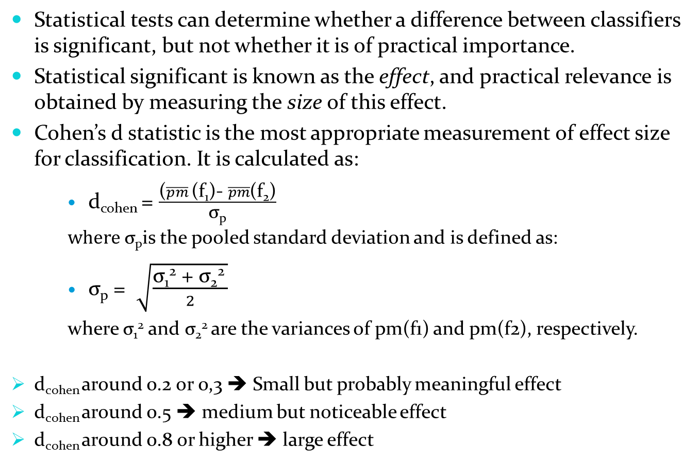
Two Classifiers/One Domain: Frequentist, Estimation Statistics: Effect Size

Slide 38
Two Classifiers/One Domain: Bayesian Statistics: the correlated t-test I
Accuracy(DecisionTree) – Accuracy(SVM) on the UCI labor dataset
The ROPE is small and the difference falls mostly on the negative side
SVM’s performance is most often superior to that of DecisionTree.

Slide 39
Two Classifiers/One Domain: Bayesian Statistics: the correlated t-test II
High Density Intervals show the intervals where 50%, 60%, etc. of the data is concentrated.
They can be interpreted in a way similar to the way Frequentist confidence intervals are.

Slide 40
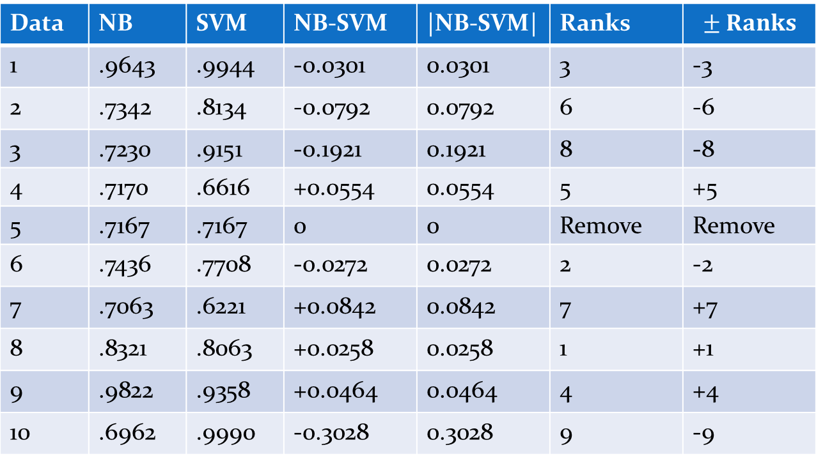
Two Classifiers/Multiple Domains: Frequentist, non-parametric test: Wilcoxon’s signed ranked test
Data | NB | SVM | NB-SVM | |NB-SVM| | Ranks
1 | .9643 | .9944 | -0.0301 | 0.0301 | 3 | -3
2 | .7342 | .8134 | -0.0792 | 0.0792 | 6 | -6
3 | .7230 | .9151 | -0.1921 | 0.1921 | 8 | -8
4 | .7170 | .6616 | +0.0554 | 0.0554 | 5 | +5
5 | .7167 | .7167 | 0 | 0 | Remove | Remove
6 | .7436 | .7708 | -0.0272 | 0.0272 | 2 | -2
7 | .7063 | .6221 | +0.0842 | 0.0842 | 7 | +7
8 | .8321 | .8063 | +0.0258 | 0.0258 | 1 | +1
9 | .9822 | .9358 | +0.0464 | 0.0464 | 4 | +4
10 | .6962 | .9990 | -0.3028 | 0.3028 | 9 | -9
W_{S1} = 17 and W_{S2} = 28 ➔ T_{Wilcox} = min(17, 28) = 17
For n= 10-1 degrees of freedom and α = 0.005, V = 8 for the 1-sided test. V must be larger than
T_{Wilcox} in order to reject the hypothesis. Since 17 > 8, we cannot reject the hypothesis that NB’s
performance is equal to that of SVM at the 0.005 level.

Slide 41
Two Classifiers/Multiple Domains: Bayesian statistics: Bayesian hierarchical correlated t-test

Slide 42
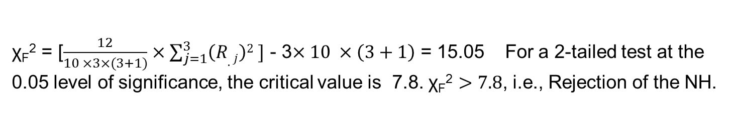
Multiple Classifiers/Multiple Domains: Frequentist, non-parametric statistics: Friedman’s test
Domain | Classifier fA | Classifier fB | Classifier fC
1 | 1 | 3 | 2
2 | 1.5 | 3 | 1.5
3 | 1 | 3 | 2
4 | 1 | 3 | 2
5 | 2 | 3 | 1
6 | 1 | 3 | 2
7 | 2 | 3 | 1
8 | 2 | 3 | 1
9 | 2 | 3 | 1
10 | 2 | 3 | 1
R _{.j} | 15.5 | 30 | 14.5
Domain | Classifier fA | Classifier fB | Classifier fC
1 | 85.83 | 75.86 | 84.19
2 | 85.91 | 73.18 | 85.90
3 | 86.12 | 69.08 | 83.83
4 | 85.82 | 74.05 | 85.11
5 | 86.28 | 74.71 | 86.38
6 | 86.42 | 65.90 | 81.20
7 | 85.91 | 76.25 | 86.38
8 | 86.10 | 75.10 | 86.75
9 | 85.95 | 70.50 | 88.03
19 | 86.12 | 73.95 | 87.18

Slide 43
Multiple Classifiers/Multiple Domains: Frequentist, non-parametric statistics: Nemenyi’s test

Slide 44
Recommendations
Familiarize yourself with all the statistical methods available for the specific settings of your task.
Match the settings with the most appropriate methods.
Ensure that your choice does not violate any constraints and that if it does, you fully understand the consequences of that violation.
Ensure that you understand the limitations of the statistical methods you selected so as not to make exaggerated claims.

Slide 45
Machine learning settings other than classification
Settings related to classification

Slide 46
Overview of supervised settings other than classification

Slide 47
Some examples: Regression I

Slide 48
Some examples: Regression II

Slide 49
Some examples: multi-label classification I
Example-based metrics: consider each test example and all its labels separately, assign a performance value to them and calculate the mean of the performance values obtained on the entire testing set.
Label-based metrics: treat the testing set as L testing sets, one for each label where L is the total number of labels, use regular classification metrics on each “testing set", and aggregate the results using micro-, macro -or weighted- average.

Slide 50
Some examples: multi-label classification II
Exact Match Ratio:
0/1 Loss = 1- EMR
Hamming Loss:
Hamming Score:
Results:
EMR = ¼ = .25 (only one instance matches perfectly;
o/1 Loss = 3/4 = .75
HL = 4/16 = .25
HS = ¼ (3/4+1/3+2/2+1/2)= .646
Example
Ground Truth
Predictions

Slide 51
Machine learning settings other than classification
Unsupervised Learning

Slide 52
Metrics for Clustering: intrinsic versus extrinsic metrics

Slide 53
Exanple of an intrinsic metric: DBI
Left Right
Left :
Right:

Slide 54
Assessing GANs’ performance: Inception Score (IS) and Frechet Inception Distance (FID)

Slide 55
Machine Learning Deployment

Slide 56
Toward Deployment: Testing Standards in Software Engineering
Software development matured from experimental practice to an engineering field in the 1980s-1990s. Aim: to create reliable software systems for real-world applications
Sub-Disciplines of Software Engineering
Software Requirements: Understand client needs and define software functionality
Software Design: Build conceptual architecture; define components and their interactions
Software Development: Implement system with basic testing and optimization
Software Testing: Ensure system functions as expected; identify and resolve bugs
Software Maintenance: Plan for future changes and adaptability

Slide 57
Toward Deployment: Testing Standards in Software Engineering
Types of Testing
White-Box Testing: Examines internal code structure, targeting vulnerabilities
Black-Box Testing: Tests functionality without code knowledge; applied at unit, integration, or system levels
Gray-Box Testing: Combines both approaches for targeted testing
Challenges in Machine Learning Testing
ML systems are non-deterministic, adding complexity to testing
Requires adapting traditional software testing standards to address unique ML challenges (e.g., unpredictability, performance variability)

Slide 58
Adapting Testing Standards: Non-Determinism in Machine Learning Systems
Data Dependence: ML models are highly sensitive to the datasets they are trained on; variations in data can lead to different model outcomes.
Algorithmic Bias:
Example: Maximum-margin linear classifiers may yield different results based on training data.
Removing specific biases increases variability (e.g., infinite potential classifiers even within linear models).
Parameter Complexity:
Linear Models: Fewer parameters, but still influenced by bias and data variability.
Nonlinear Models: High-variance behavior (e.g., KNN’s data sensitivity, DNN’s initialization and parameter randomness).
Result: Higher parameterization and complexity in ML systems generally increase non-deterministic outcomes.

Slide 59
Adapting Testing Standards: Testing ML Software – By Zhang et al. (2022)
Conditions for Testing:
Functional Requirements:
Correctness: System should output expected results.
Model Relevance: Avoid underfitting/overfitting.
Non-Functional Requirements:
Efficiency, robustness, fairness, security, privacy, interpretability.
Components to Test:
Data: Check for noise, imbalance.
Learning Algorithm: Ensure proper tuning, identify bugs.
Framework/Platform: Detect issues in platforms like Scikit, Keras.
Testing Workflow:
Offline Testing: Formal assessments and model validation.
Online Testing: Real-time monitoring, user feedback, A/B testing.

Slide 60
Handling imperfections
Data Challenges in ML Systems:
Data Access Constraints: Privacy laws (e.g., HIPAA) and NDAs limit access to training data.
Central Role of Data in ML:
Sufficient sample size?
Correct data representation?
Noise-free data?
Overlap in modeled populations?
Types of Bias (Mehrabi et al., 2021):
Historical Bias: Algorithms reflect societal inequalities (e.g., COMPASS, Amazon recruitment).
Representation Bias: Under- or over-representation of certain groups (e.g., Buolamwini and Gebru’s study on facial recognition misclassifying dark-skinned individuals).

Slide 61
Handling imperfections: Data Management & Mitigation Techniques
Technical Approaches to Mitigate Bias & Data Issues (Roh et al., 2021):
Data Acquisition: Data sharing (e.g., Kaggle, Data Lakes) and data search (e.g., GOODS).
Data Augmentation: Adding external knowledge (e.g., Word2Vec, GLoVE).
Data Generation: Crowdsourcing (Mechanical Turk) and synthetic data (e.g., GANs).
Data Labeling: Crowdsourcing, active learning, weak supervision.
Data Cleaning: Removing noise from features/labels.
Algorithmic Robustness: Utilizing adversarial examples, transfer learning to improve model resilience.

Slide 62
Online testing of Machine Learning Systems
Limitations of Offline Testing:
Offline testing only simulates real-world behavior, relying on historical data.
May not account for unexpected future scenarios or real-time issues post-deployment.
Online Testing Approaches (Zhang et al., 2022):
Runtime Monitoring: Continuous tracking of system behavior to detect runtime issues like races or deadlocks.
User Response Monitoring:
A/B Testing: Compares new and old model versions with user cohorts to assess performance improvements.
KPI Tracking:
Monitors key business metrics to ensure the model aligns with strategic goals and enhances performance.

Slide 63
Current industry practices in ML Deployment
Deployment Issues
Slow Deployment Rate: Transition from lab models to production is often slow (e.g., Alexa, Siri, assisted driving).
Skill Gaps: Data scientists lack training for end-to-end deployment; models often remain unutilized due to deployment gaps (Patruno, Kaptein).
Comprehensive Process Needed:
AI-Driven Workflow:
Stages: Data Prep → AI Modeling → Simulation & Testing → Deployment.
Simulation Limits: Must ensure model robustness across scenarios but may not capture all edge cases.

Slide 64
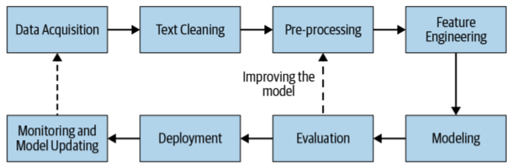
Current industry practices in ML Deployment
Integration Testing
Pipeline Reliability:
Entire ML pipeline should undergo testing before deployment to catch issues that affect multiple components.
Importance: Small changes in one component can disrupt the entire pipeline, stressing the need for comprehensive integration tests.
A traditional Natural Language Processing Pipeline

Slide 65
MLOps: The Next Level in ML Deployment
MLOps Framework
Adaptation of DevOps Principles:
Version Control Expansion: Applies not only to code but also to data, parameters, and training processes.
Documentation: Ensures consistent standards across development and production stages, aiding reproducibility.
Automated Safeguards:
Embeds data collection, cleaning, and testing procedures directly into code to standardize processes.
Prevents ad-hoc, non-replicable steps in ML pipelines.
Continuous Pipeline Maintenance
Dynamic Data Handling: ML models require periodic retraining to remain accurate.
Pipeline Management:
Ensures smooth transitions and updates across model iterations, maintaining system continuity.

Slide 66
Improve safe development of ML systems
Challenges of Rapid Deployment
Potential Risks: Fast deployment may compromise safety and thorough testing, risking poorly vetted ML-based products.
Case-Specific Standards: Safety measures must match the product’s impact (e.g., self-driving cars vs. voice recognition). Proper offline and online testing remains essential to avoid harm and PR issues.
Proposed Enhancements for Safe Deployment
Calibration Needs: Algorithms should accurately estimate probabilities, especially in critical fields like healthcare, to prevent unnecessary risks and costs.
Quality Assurance (QA) Inspirations:
QA and QC Methods: Adopt rigorous QA/QC standards from software engineering to meet fixed goals.
Clinical Trial Approach: Implement independent, clinical-trial-like evaluations for ML algorithms to ensure robustness and fair competition.

Slide 67
Improving Ethical Considerations

Slide 68
Principles of Responsible Machine Learning
Data Bias Detection and Mitigation Ensuring that machine learning models are trained on unbiased and representative data, and that potential biases in the data are detected and addressed.
Explainability and Interpretability Ensuring that machine learning models are transparent and explainable, and that their decisions and predictions can be understood and evaluated by users.
Model Fairness and Non-Discrimination Ensuring that machine learning models do not discriminate against individuals or groups based on factors such as race, gender, or religion.
Data Privacy and Security Respecting the privacy and data protection rights of individuals, and ensuring that personal data is collected, processed, and used in a responsible and ethical manner.
Human-Centered Machine Learning Ensuring that machine learning models are developed with the needs and values of users and society in mind.
Reproducible Machine Learning Ensuring that machine learning models can be replicated and verified by independent parties.

Slide 69

Data bias detection and mitigation
Data bias is a systematic error in datasets that leads to unfair or skewed model outcomes.
https://spotintelligence.com/2024/05/14/bias-mitigation-in-machine-learning/
Techniques:
Statistical analysis
Descriptive Statistics: Explore data distribution and characteristics.
Regression Analysis: Examine relationships between variables.
T-test, ANOVA: Test for independence between categorical variables.
Chi-square test: Compare means across groups.
Blind testing
Data augmentation

Slide 70
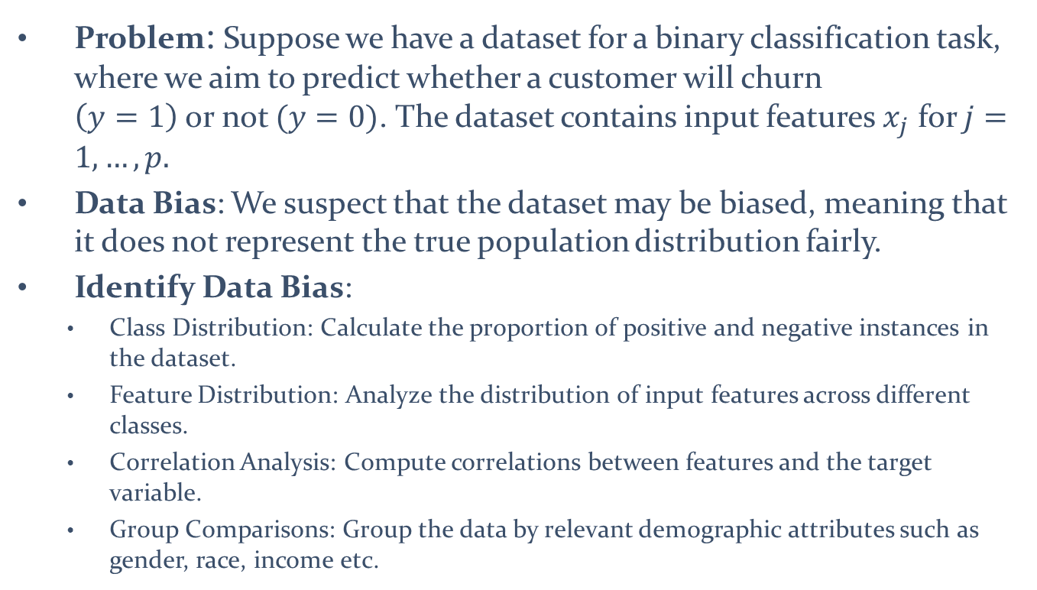
Statistical Analysis a Case Problem Predicting Customer Churn
Problem: Suppose we have a dataset for a binary classification task, where we aim to predict whether a customer will churn $\left(y=1\right)$ or not $(y=0)$. The dataset contains input features $x_{j}$ for $j=1,…,p.$
Data Bias: We suspect that the dataset may be biased, meaning that it does not represent the true population distribution fairly.
Identify Data Bias:
Class Distribution: Calculate the proportion of positive and negative instances in the dataset.
Feature Distribution: Analyze the distribution of input features across different classes.
Correlation Analysis: Compute correlations between features and the target variable.
Group Comparisons: Group the data by relevant demographic attributes such as gender, race, income etc.

Slide 71
Addressing Data Bias Predicting Customer Churn
If data bias is identified, it is essential to address it to ensure fair and accurate predictions. Possible strategies include:
Collecting more data: If possible, collect more data to improve representation and reduce bias in the dataset.
Data augmentation: Use techniques such as oversampling or synthetic data generation to balance the dataset and increase representation for underrepresented groups.
Feature engineering: Modify or create new features that capture important characteristics for underrepresented groups, thereby reducing bias in feature representation.
Algorithmic modifications: Explore fairness-aware algorithms that explicitly incorporate fairness constraints during model training to mitigate bias.

Slide 72
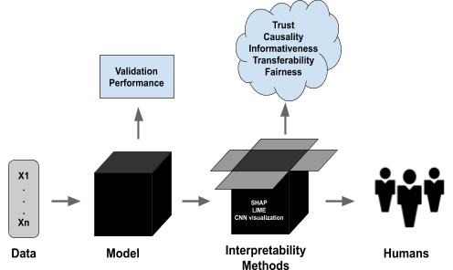
Explainability and Interpretability
XML focuses on creating ML models that provide interpretable, understandable explanations for predictions, enhancing trust and transparency.
https://blog.ml.cmu.edu/2020/08/31/6-interpretability/
Techniques:
Model Visualization: Shows model structure and data relationships.
Feature Importance Ranking: Highlights key features influencing predictions.
Local Explanations: Explains individual predictions, improving transparency.

Slide 73
Taxonomy of XML Techniques
Model-agnostic vs. Model-specific: Model-agnostic techniques are adaptable to any model, while model-specific techniques are tailored for particular model types.
Rule-based vs. Model-based: Rule-based techniques rely on explicit rules for explanations, while model-based techniques use the model's internal mechanisms, such as feature importance, to generate explanations.
Post-hoc vs. Ante-hoc: Post-hoc XML techniques create explanations after the model's prediction, while ante-hoc XML techniques provide explanations during training
Local vs. Global: Local XML techniques explain individual predictions, while global XML techniques provide insight into the model’s overall behavior and patterns.
Human-centric vs. Machine-centric: Human-centric techniques aim to create explanations that are clear and useful for people, whereas machine-centric XML techniques prioritize efficiency for machine processing.
Qualitative vs. Quantitative: Qualitative techniques provide explanations in human-readable forms while quantitative techniques offer explanations as statistical or mathematical measures.
Interactive vs. Static: Interactive techniques let users explore scenarios and conduct what-if analyses, while static techniques provide fixed explanations.

Slide 74
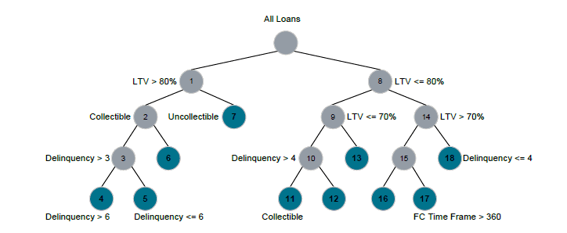
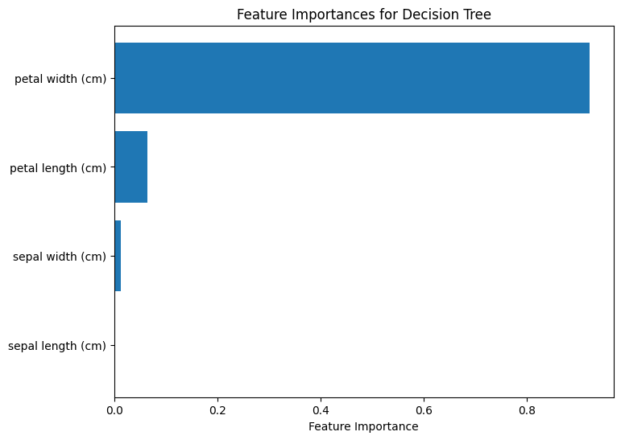
Decision Trees
Decision trees are interpretable machine learning models that visually represent decision-making processes, providing insights into data patterns.
An example using Iris dataset:
Features:
Sepal Length (cm)
Sepal Width (cm)
Petal Length (cm)
Petal Width (cm)
Target: Classify iris flowers into one of three species. “Setoca”, “Versicolor”, “Virginica”.

Slide 75
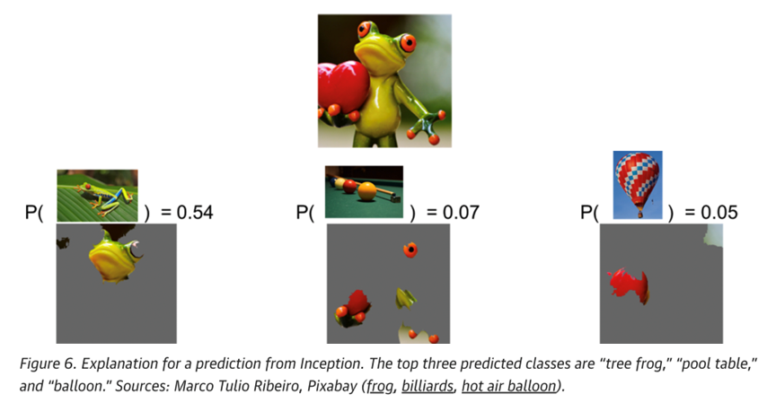
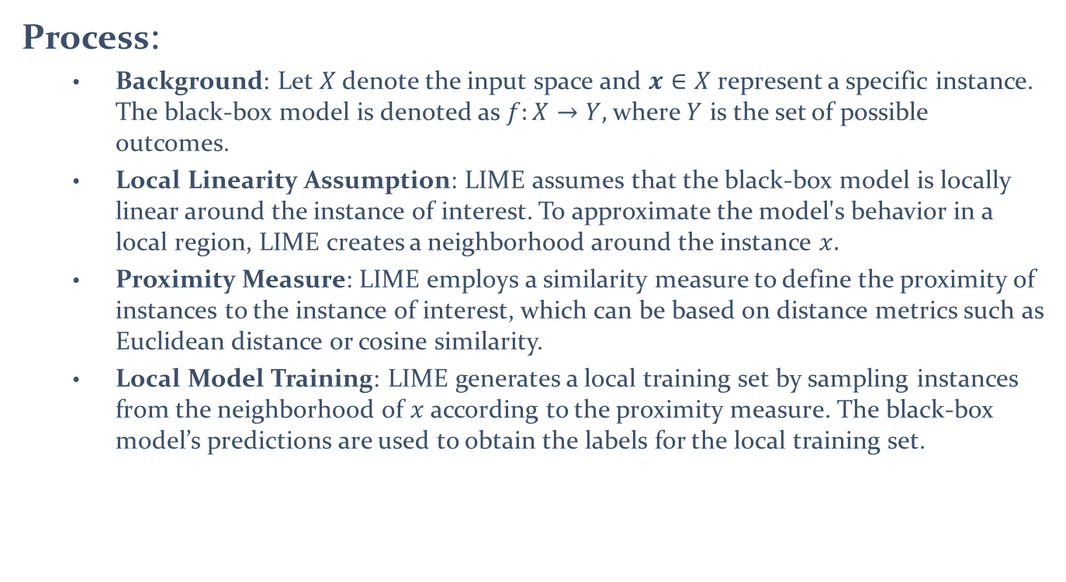
Local Interpretable Model-Agnostic Explanations (LIME)
Model is making the right prediction in a right way
Ribeiro, M.T., Singh, S. and Guestrin, C., 2016, August. " Why should i trust you?" Explaining the predictions of any classifier. In Proceedings of the 22nd ACM SIGKDD international conference on knowledge discovery and data mining (pp. 1135-1144).
Process:
Background: Let $X$ denote the input space and $x∈X$ represent a specific instance. The black-box model is denoted as $f:X→Y,$ where $Y$ is the set of possible outcomes.
Local Linearity Assumption: LIME assumes that the black-box model is locally linear around the instance of interest. To approximate the model's behavior in a local region, LIME creates a neighborhood around the instance $x.$
Proximity Measure: LIME employs a similarity measure to define the proximity of instances to the instance of interest, which can be based on distance metrics such as Euclidean distance or cosine similarity.
Local Model Training: LIME generates a local training set by sampling instances from the neighborhood of $x$according to the proximity measure. The black-box model’s predictions are used to obtain the labels for the local training set.

Slide 76
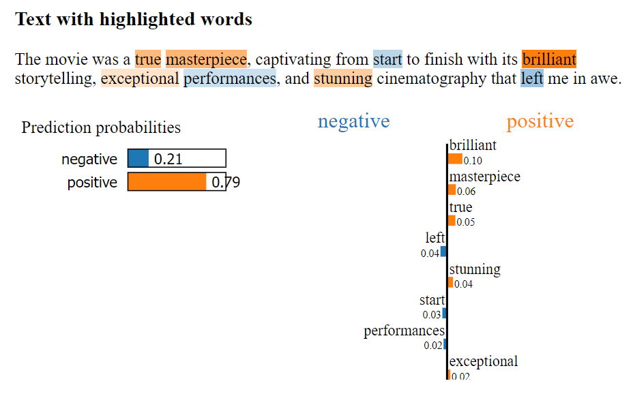
LIME for a natural language processing task
Application: Use of LIME to interpret predictions from a logistic regression classifier applied to sentiment analysis on IMDb movie reviews. Text data is converted into numerical features using TF-IDF vectorization, and the model's performance on training data is evaluated.
LIME enhances model transparency by explaining specific predictions, showing how particular words or phrases influence the sentiment classification, which is crucial for understanding and trusting NLP models in real-world applications.
Results: Visually highlights the key words or features driving the logistic regression classifier’s positive sentiment prediction for a movie review, focusing on the top eight influential words to clarify how specific terms contribute to the model's decision.

Slide 77
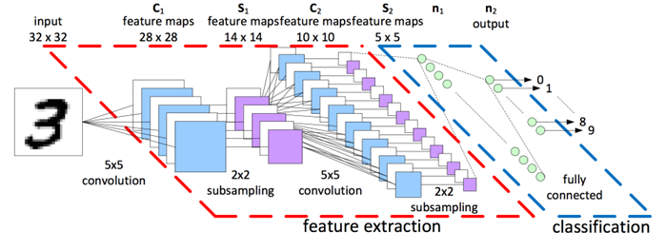
Heat Maps
Convolutional neural networks (CNNs) are deep learning models designed to process and analyze visual data by automatically detecting patterns through layers of convolutional filters.
Visualizing heatmaps of class activation:
This technique is a type of class activation map (CAM) visualization, producing heatmaps to highlight image regions most relevant to a class prediction.
Grad-CAM (Gradient-weighted Class Activation Mapping) generates class activation heatmaps by weighting the channels in a CNN’s feature map based on the gradient of the predicted class score.
In simple terms, Grad-CAM highlights the most important parts of the feature map for predicting a specific class by calculating how much each channel contributes to the class score.
Grad-CAM creates a heatmap that highlights image regions most influential in predicting the target class, offering visual insight into the CNN’s decision-making process.

Slide 78
Heat Maps in Computer Vision
Application: Using the pre-trained Xception model, we aim to understand two key questions:
Why did the model classify this image as a 'Pembroke' dog?
Which regions in the image are most influential for this classification?
The workflow:
To pinpoint regions relevant to the 'Pembroke' classification, we set up the Grad-CAM workflow by creating two models:
One maps the input image to the last convolutional layer activations.
The other maps these activations to the final class predictions.
We compute the gradient of the predicted class with respect to the last gradient convolutional layer activations.
The class activation heatmap is created by pooling and weighting the gradient tensor, then normalized to 0–1 for visualization.
The heatmap is overlaid on the original image, highlighting key areas influencing the 'Pembroke' classification.

Slide 79

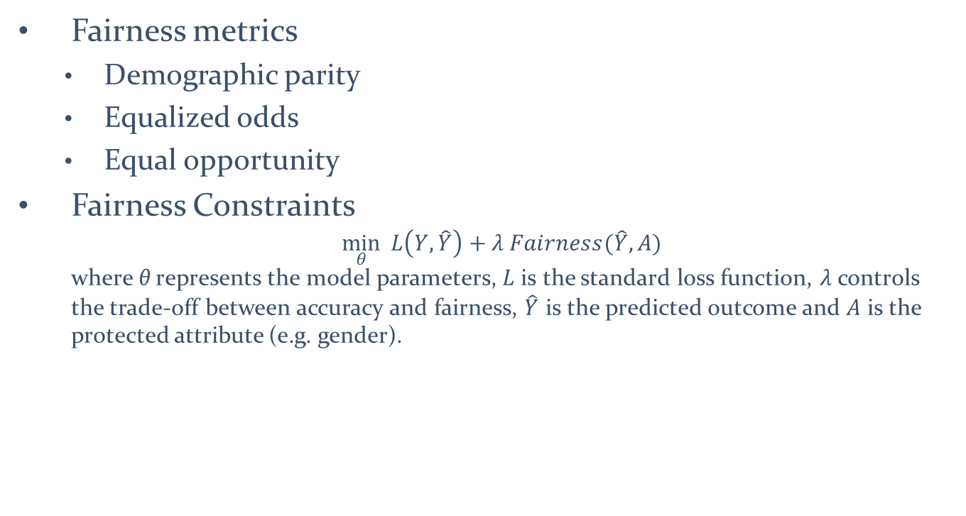
Model Fairness and Non-Discrimination
Fairness in machine learning refers to ensuring that models make decisions without bias or discrimination, treating all groups or individuals equitably.
Fairness metrics
Demographic parity
Equalized odds
Equal opportunity
Fairness Constraints $\min_{θ}{ L\left(Y,\hat{Y}\right)+λ Fairness(\hat{Y},A) }$ where θ represents the model parameters, $L$ is the standard loss function, $λ$controls the trade-off between accuracy and fairness, $\hat{Y}$ is the predicted outcome and $A$ is the protected attribute (e.g. gender).
https://www.turing.ac.uk/sites/default/files/2023-12/aieg-ati-fairness_1.pdf

Slide 80

Data Privacy and Security
Data privacy and security are crucial considerations in machine learning projects and vital in responsible machine learning.
https://www.traverselegal.com/blog/ai-data-privacy-and-security/
Privacy-preserving techniques
Differential privacy
Secure multi-party computation
Federated learning
Homomorphic encryption
Secure aggregation
Data perturbation
Privacy-preserving data publishing

Slide 81
Data Privacy and Security
Data anonymization and de-identification
Data anonymization
K-Anonymity
L-Diversity
T-closeness
Secure data storage and transfer
Encryption
Secure protocols
Access control
Data integrity
Secure storage infrastructure
User consent and data usage policies
Secure infrastructure and system hardening

Slide 82

Human-Centered Machine Learning
Human-Centered Design in Machine Learning
Engage users and stakeholders throughout the design process to understand their needs, challenges, and goals.
Use methods such as user research, surveys, and focus groups to gather feedback.
https://hcai.site/
Develop user personas to represent diverse user types and needs.
Design an intuitive, accessible, and easy-to-use user experience.
Incorporate user feedback to refine and improve the model.
Test with real users to evaluate effectiveness, usability, and impact.

Slide 83
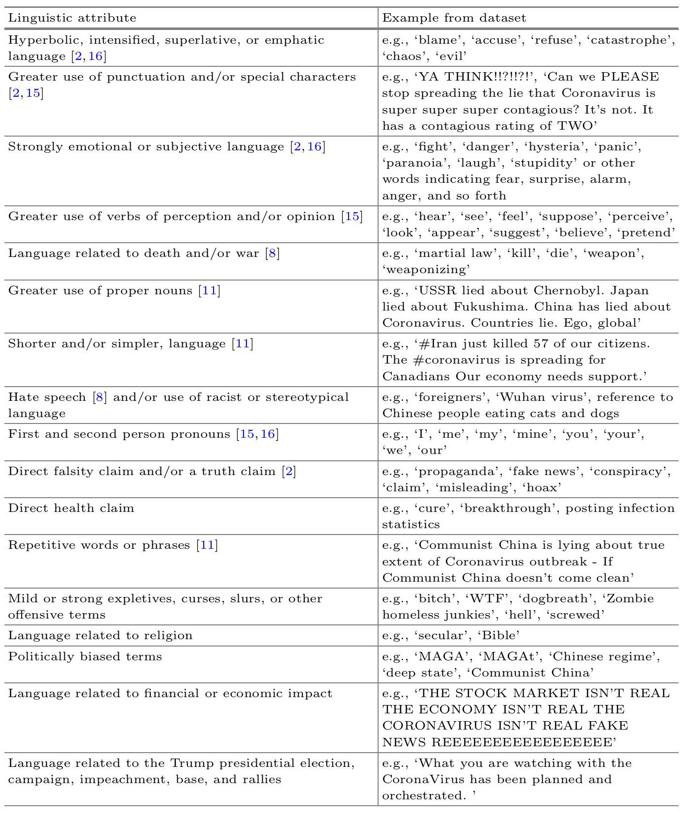
Example of Human-Centered ML
Moroney et al. (2021): Developed a social media dataset and linguistic rules to evaluate the interpretability of a classification model for unreliable tweets, promoting usability and user relevance
17 linguistic characteristics identified in a list of 560 tweets
Moroney, C., Crothers, E., Mittal, S., Joshi, A., Adalı, T., Mallinson, C., Japkowicz, N. and Boukouvalas, Z., 2021. The case for latent variable vs deep learning methods in misinformation detection: An application to covid-19. In Discovery Science: 24th International Conference, DS 2021, Halifax, NS, Canada, October 11–13, 2021, Proceedings 24 (pp. 422-432). Springer International Publishing.

Slide 84
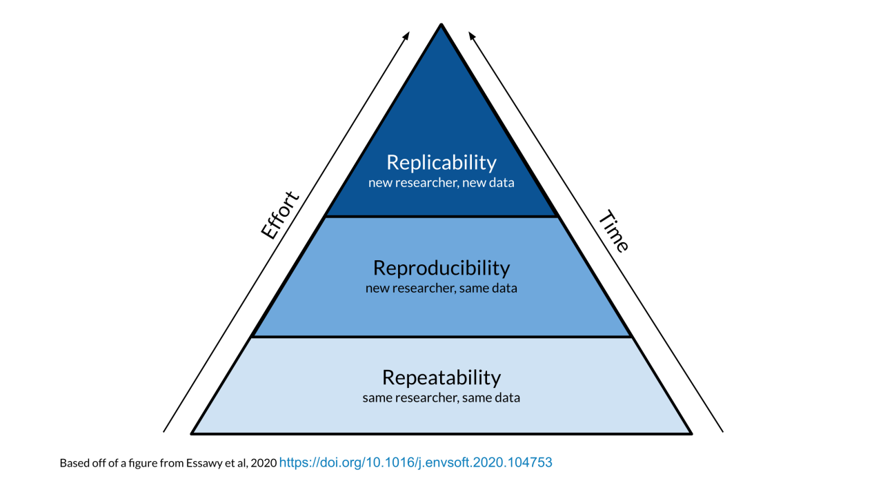
The Rs in machine learning

Slide 85
Reproducible Machine Learning
Repeatability: Refers to the ability to reproduce the same results when an experiment is conducted multiple times, using the same dataset, model, and experimental setup.
Example: Consider a machine learning experiment where researchers train a CNN for image classification using a publicly available dataset.
Seed Initialization: Set the random seed at the beginning of the experiment.
Code Versioning: Maintain a version-controlled repository for the codebase used in the experiment.
Documentation: Keep detailed records of the experimental setup, including hyper parameters, preprocessing steps, and model architecture.
Hardware and Software Specifications: Specify the hardware and software con-figurations used, including the type and version of the machine learning framework, libraries, and dependencies.

Slide 86
Reproducible Machine Learning
Reproducibility: Refers to the ability to recreate and validate the results of a study or experiment using the same data, code, and methods.
Example: Consider a machine learning study where researchers develop a deep learning model for sentiment analysis on a specific dataset. To ensure reproducibility, the following steps can be taken. Data Availability: Make the dataset used in the study publicly available or provide detailed information about how to obtain the dataset. This ensures that other researchers can access the same data and reproduce the experiments.
Code Sharing: Share the code and scripts used to preprocess the data, train the model, and evaluate the results. Version control tools like Git can be used to maintain a repository that includes the code and its dependencies.
Documentation: Provide comprehensive documentation that describes the experimental setup, including details about hyperparameters, model architecture, and any pre-processing steps. This documentation helps in reproducing the experiments accurately.
Environment Description: Specify the software and hardware configurations used in the study, including the version of the machine learning framework, libraries, and dependencies. This information helps in replicating the experiments on different systems.

Slide 87
Reproducible Machine Learning
Replicability: Refers to the ability to reproduce the results of a study or experiment using independent data and methods.
Example: Consider a machine learning study where researchers propose a novel algorithm for image classification. To ensure replicability, the following steps can be taken. Independent Data Collection: Collect a separate and independent dataset that is different from the one used in the original study. This ensures that the findings can be tested on new data.
Method Replication: Replicate the methodology described in the original study, including data preprocessing steps, feature extraction techniques, and model training procedures. Ensure that the implementation details are as close as possible to the original study.
Comparison and Evaluation: Apply the replicated method to the new dataset and compare the obtained results with the original study. Assess the similarity of the outcomes, such as classification accuracy or other relevant performance metrics.
Discussion and Interpretation: Discuss the similarities and differences observed between the replicated results and the original findings.

Slide 88
Reproducible Machine Learning Challenges
Reproducibility is a critical aspect of scientific research, including machine learning. Some of the challenges include:
Data Availability: Many studies use proprietary or restricted datasets, limiting replication efforts. Solutions include promoting open data practices, sharing platforms, and detailed instructions for data access.
Code and Software Dependencies: Machine learning experiments rely on complex code with many dependencies, where version differences in software packages can disrupt reproducibility. Sharing code and specifying software dependencies clearly can help address this issue.
Hyperparameter Tuning: Machine learning models often require tuning hyperparameters for optimal performance, but these choices can greatly impact results, complicating reproducibility. Clear documentation of the chosen hyperparameters and their rationale can help mitigate this issue.
Hardware and Computational Resources: Machine learning experiments often demand specific hardware, and variations in computational environments can affect reproducibility. Documenting the hardware and resources used can help others replicate the experiments.

Slide 89
Solutions to make ML projects reproducible
Tracking Experiment Metadata: Experiment tracking involves recording important meta-data associated with each experiment. This includes information such as the date and time of the experiment, the machine learning algorithm used, hyperparameters, dataset details, and any preprocessing steps applied. Tracking this metadata helps in understanding and reproducing the experiment’s results.
Managing Code Versions: Experiment tracking and logging also involve managing code versions. It is essential to keep track of the code used for each experiment, including the specific commit or version. This ensures that the exact code used can be reproduced and traced back to the experiment’s results. Tools for Experiment Tracking and Logging: Several tools and frameworks are available for experiment tracking and logging in machine learning. Examples include MLflow, Neptune, Sacred, and TensorBoard. These tools provide features such as experiment versioning, result visualization, and collaboration functionalities.
Version Control: Version control is an essential aspect of an artifact store. It allows trackingand managing different versions of artifacts, such as models and datasets. This enablesreproducibility and ensures that previous versions can be easily retrieved and compared.

Slide 90
Summary and Conclusion
Key Topics Covered:
Classification techniques
Selecting performance measures
Sampling strategies
Statistical tests
Alternative ML paradigms
Deployment practices for reliability and responsibility
Importance of Evaluation in Machine Learning
Central Role of Evaluation:
Ensures accuracy and robustness in models
Helps prevent misinterpretation and supports rigorous validation
Beyond Technical Performance:
Emphasizes the social and ethical impact of ML
Ensures trust and accountability in real-world applications

